Slide 1

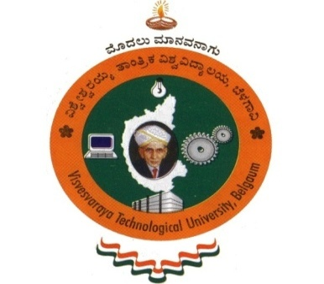
Detection of liver cancer using Image processing techniques
Bangalore Institute of Technology
K.R. Road, V V Puram, Bangalore-560004
Department of Electronics and Communication Engineering
MINI-PROJECT PRESENTATION
Under the guidance of:
Presented by
Guide Name: Dr. Narendra CP
Designation: - Associate Professor
Dept. of ECE
BIT.
Name: Aditya Choudhary Name: Rupesh Ranjan Singh
USN: 1BI20EC010 USN: 1BI20EC120
Name: Anuraj Anand Name: Abhay Kumar
USN: 1BI20EC019 USN: 1BI20EC002

Slide 2
INSTITUTE VISION AND MISSION
Vision
Establish and develop the Institute as the Centre of higher learning, ever abreast with expanding horizon of knowledge in the ﬁeld of Engineering and Technology with entrepreneurial thinking, leadership excellence for life-long success and solve societal problems.
Mission
Provide high quality education in the Engineering disciplines from the undergraduate through doctoral levels with creative academic and professional programs.
Develop the Institute as a leader in Science, Engineering, Technology, Management and Research and apply knowledge for the beneﬁt of society.
Establish mutual beneﬁcial partnerships with Industry, Alumni, Local, State and Central Governments by Public Service Assistance and Collaborative Research.
Inculcate personality development through sports, cultural and extracurricular activities and engage in social, economic and professional challenges.
Bangalore Institute of Technology
Dept. of ECE, BIT

Slide 3
DEPARTMENT VISION , MISSION, PEOs, PSOs
Vision
Imparting Quality Education to achieve Academic Excellence in Electronics and Communication Engineering for Global Competent Engineers.
Mission
Create state of art infrastructure for quality education.
Nurture innovative concepts and problem solving skills.
Delivering Professional Engineers to meet the societal needs.
PEOs
Prepare graduates to be Professionals, Practicing Engineers and entrepreneurs the field of Electronics and Communication Engineering.
To acquire sufficient knowledge base for innovative techniques innovative techniques in design and development of systems.
Capable of competing globally in multidisciplinary field.
Achieve personal and professional success with awareness and commitment to ethical and social responsibilities as an individual as well as a team.
Graduates will maintain and improve technical competence through continuous learning process.
Bangalore Institute of Technology
Dept. of ECE, BIT

Slide 4
DEPARTMENT VISION , MISSION, PEOs, PSOs
PSOs
PSO1: The graduates will be able to apply the Principles of Electronics and Communication Engineering in core areas.
PSO2:An ability to use the latest hardware and software tools in Electronics and Communication Engineering
PSO3: Preparing Graduates to satisfy industrial needs and pursue higher studies with social awareness and universal moral values.
Bangalore Institute of Technology
Dept. of ECE, BIT

Slide 5
Course Outcomes of Mini-Project
1 | Ability to carry-out literature review and define the problem.
2 | Ability to co-ordinate to work as a team member or a single member.
3 | Inculcate methods to use advance tools .
4 | Design analytical modeling and develop a systems
5 | Ability to equip analysis skills and interpretation.
6 | Enhance presentation skills, drafting and documentation of project work.
CO-PO Mapping Table
PO CO | 1 | 2 | 3 | 4 | 5 | 6 | 7 | 8 | 9 | 10 | 11 | 12 | PSO 1 | PSO 2 | PSO 3
1 | 3 | 2 | 2 |  |  | 1 |  | 1 | 1 | 1 |  |  | 2 | 2
2 | 3 | 2 | 2 |  |  | 1 |  | 1 | 1 | 1 |  |  | 2 | 2
3 | 3 | 2 | 2 |  | 3 |  |  | 1 | 1 | 1 |  |  | 2 | 2
4 | 3 | 2 | 2 |  | 3 | 1 |  | 1 | 1 | 1 |  |  | 2 | 2
5 | 3 | 2 | 2 |  | 3 | 1 |  | 1 | 1 | 1 |  |  | 2 | 2
6 | 3 |  |  |  | 3 |  |  | 1 | 1 | 1 | 2 |  | 2 | 2
Bangalore Institute of Technology
Dept. of ECE, BIT

Slide 6
ABSTRACT
The abnormal growth of cells in the liver causes liver cancer which is also known as hepatic cancer, where, Hepatocellular Carcinoma (HCC) is the most common type of liver cancer which makes up 75% of cases.
The detection of this tumour is difficult and mostly found at advanced stage which causes life-threatening issues. Hence it is far essential to discover the tumour at an early stage.
The principle intention of this project is to detect liver cancer at earlier stage using image processing technique.
Here the malignant liver tumours are detected from Computed Tomography (CT) images. The image undergoes enhancement using anisotropic diffusion filters and segmented by morphological operations which is simple and easy to work.
This operation uses combination of two processes, dilation and erosion.
The scope of this propounded technique is to highlight the tumour region present in the Computed Tomography.
Bangalore Institute of Technology
Dept. of ECE, BIT

Slide 7
CONTENTS
ABSTRACT
INTRODUCTION
LITERATURE SURVEY
OBJECTIVES
METHODOLOGY
IMPLEMENTATION
RESULTS & OBSERVATIONS
CONCLUSION
REFERENCES
Bangalore Institute of Technology
Dept. of ECE, BIT

Slide 8
INTRODUCTION
The formulation of the term cancer was in 460 - 370 BC. It is credited to the Greek Physician Hippocrates who is known as “FATHER OF MEDICINE”. Billions of cells in our body divides each day to produce new cells. The newly formed cells occupies the space of dead cells. Basically, cells get together to form tissues, tissues get together to form organs. Hence, in some abnormal cases, cells divide more than the body needed and form as lumps or growths normally called as tumors.In this project we proposed simple method of cancer detection using image processing.
Digital image processing is the technique of using computers to process the image with the necessary algorithms. The software used here is MATLAB. Computed tomography image of liver cancer is employed to detect the tumor region. Detection of liver cancer involves three main steps. It includes preprocessing of image, processing of image and highlighting tumor region. Preprocessing of image involves image enhancement using anisotropic diffusion filter to remove noise and imperfections in image. During thresholding, there may be some chance of noise creation. This step plays an important role in detection of cancer, because a small deviation which may be caused due to imperfections or noise will leaves a major effect in detection process. After image enhancement, image is segmented for detection of tumor region in processing stage. For segmenting image, morphological operations are used. It includes dilation and erosion which is the basic process for completing the whole detection operation.
Morphological operations are simple and very easy to work because it operates on basic set theory and does not contain complex mathematical equations. The last step is to highlight the tumor region in the given image for easy and clear observation. For understanding the whole process obviously, the sub plotted image of all processed image is shown which includes original image, filtered image, tumor region, bordered tumor image and highlighted tumor region in original given image
Bangalore Institute of Technology
Dept. of ECE, BIT

Slide 9
LITERATURE SURVEY
[1]Rong Zhu, et.al.,“Application of Improved Anisotropic diffusion Filter on Image Processing” proposed that anisotropic diffusion filter is the most commonly used method in removing noises. This paper describes the improved algorithm of anisotropic diffusion filter to remove salt and pepper noises of the images
[2]Ravi S, et.al.,“Morphological Operations for Image Processing: Understanding and its applications” described morphological operations are easy to apply and it works on the principle of set theory. The objective of using this type of operation is to remove the imperfections in the structures of the images
[3]Wassem Abdulrahman, et.al.,“Diagnosis of Liver Tumors Using Image Processing” aimed to identify the specific regions of liver area in the scanner images to abdominal area. This uses a new method for extraction the region of tumor in the CT.
[4] Amit Verma, et.al., “A Survey on Digital Image Processing Techniques for Tumor Detection” describes the image processing techniques for tumor detection. It gives the best result for detecting and classifying the tumor by comparing with the existing methods.
[5] Jinshan Tang, et.al., “An Adaptive Anisotropic Diffusion Filter for Noise Reduction in MR Images” proposed The stepped forward anisotropic diffusion filter uses adaptive threshold selection. The proposed technique became carried out to real MR images and the outcomes are fantastic.
Bangalore Institute of Technology
Dept. of ECE, BIT

Slide 10
LITERATURE SURVEY
[6] Gabriel Ramos-Llordén, et.al.,“Anisotropic Diffusion Filter With Memory Based on Speckle Statistics for Ultrasound Images” recommend an anisotropic diffusion clear out with a probabilistic-pushed memory mechanism to triumph over the over-filtering problem by using following a tissue selective philosophy.
[7] Alireza Mazloumi Gavgani, et.al., “Noise reduction using anisotropic diffusion filter in inverse electrocardiology” used anisotropic diffusion filter to cancel the noise at the frame floor potentials measurements with the aim of enhancing the corresponding answers of the inverse hassle of electrocardiology.
[8] Reitseng Lin, et.al., “Morphological operations on images represented by quadtrees” proposed set of rules to directly carry out morphological operations on photographs represented via quadtrees and produce the dilated/eroded snap shots, additionally represented through quadtrees
[9] Ruchika Chandel, et.al., “Image Filtering Algorithms and Techniques” described the diverse image filtering algorithms and techniques used for image filtering/smoothing. Image smoothing is one of the most critical and widely used method in image processing.
[10] N. Howard, et.al.,“A Novel Fully automated Liver and Tumor Segmentation System using Morphological Operations” purposed to develop an automated Hepatocellular Carcinoma detection system in Computed Tomography images with high sensitivity and low specificity
Bangalore Institute of Technology
Dept. of ECE, BIT

Slide 11
OBJECTIVES (1 PAGE)
The objectives of the paper include:
Acquire an image and perform pre-processing, that includes de-noising
Find Region of Interest (ROI) and perform segmentation with algorithm to be proposed.
Compare performance of proposed algorithm with existing technique, on the bases of area of tumor, time taken for analysis and no of iterations of genetic algorithm.
Bangalore Institute of Technology
Dept. of ECE, BIT

Slide 12
METHODOLOGY
Liver cancer can be detected using several methodologies, which include:
Imaging techniques: Imaging techniques such as ultrasound, CT scan, MRI, and PET scan can help detect liver cancer. These imaging techniques can produce detailed images of the liver, allowing doctors to identify any tumors or abnormalities.
Blood tests: Blood tests can be used to detect liver cancer by measuring levels of certain markers in the blood. For example, elevated levels of alpha-fetoprotein (AFP) can indicate the presence of liver cancer.
Biopsy: A biopsy is a procedure in which a small sample of liver tissue is removed and examined under a microscope for the presence of cancer cells. This can be done using a needle inserted through the skin and into the liver or during surgery.
Bangalore Institute of Technology
Dept. of ECE, BIT

Slide 13
METHODOLOGY
Physical examination: A doctor may perform a physical examination of the liver to detect any tumors or abnormalities. This involves feeling the abdomen to check for any swelling or lumps.
Liver function tests: Liver function tests can assess how well the liver is working and can indicate the presence of liver cancer. These tests measure the levels of certain enzymes and proteins in the blood.
It is important to note that no single method is 100% accurate for detecting liver cancer, and a combination of different methods is often used to increase accuracy. It is crucial to consult with a medical professional for accurate diagnosis and treatment.
Bangalore Institute of Technology
Dept. of ECE, BIT

Slide 14
IMPLEMENTATION & DESIGN (4 PAGES)
Proposed System
The proposed system for the tumour identification is as follows:
Otsu’s Method
We apply the Otsu’s technique for the enhancement of the image. The real demo will look like this.
Watershed Segmentation
We apply the watershed segmentation technique on the image obtained by otsu’s enhancement
Active contour model
As per the instructions to try something of our own, we used the Active contour model to improve the segmented image.
Bangalore Institute of Technology
Dept. of ECE, BIT

Slide 15
IMPLEMENTATION & DESIGN (4 PAGES)
System Design
Image Enhancement
We try to enhance the original image by applying the Otsu’s method on the image. The result gives minimum combines spread and maximum inter class variance.
Image Input
Take the input image for further processing. This is the image of the MRI of the liver. It is on this image that we have to classify whether tumour is present or not.
Image Segmentation
Watershed algorithm is applied using OpenCV and further MATLAB, to segment the image easily. This can be compared with the region growing technique. We aim to apply the genetic algorithm as well.
Feature Extraction
We extract various features from the image using techniques like Principal component analysis and so on..
Bangalore Institute of Technology
Dept. of ECE, BIT

Slide 16
IMPLEMENTATION & DESIGN (4 PAGES)
Image classification
This is based on applying the K-Means clustering and Haar Wavelet transform to detect whether the cell is benign or malignant.
Result Obtained
We then superimpose the extracted features in case of Malignant, so that the tumour can be identified or visualized easily.
Software Details
Following will the software details for the same:
Python OpenCV
MATLAB
Python Flask (Later Implementation)
Google cloud (For training the model)
Any web based service for hosting.(AWS ambda, GCloud Later implementation)
Bangalore Institute of Technology
Dept. of ECE, BIT

Slide 17
IMPLEMENTATION & DESIGN (4 PAGES)
Dataset details....
The datasets are obtained from google and the sources below.
https://www.ncbi.nlm.nih.gov/pmc/articles/PMC3462338/
https://www.ncbi.nlm.nih.gov/pmc/articles/PMC5901158/
https://www.medscape.org/noscan/slideshow/757240
https://pdfs.semanticscholar.org/50d1/9cb312b91a7f9be0112e96dbb380ea5f5790.pdf
Bangalore Institute of Technology
Dept. of ECE, BIT

Slide 18
RESULTS & OBSERVATIONS
Results and observations in liver cancer detection using image processing can vary depending on the specific algorithms and techniques employed. However, here are some common outcomes and observations in this field:
Tumor Localization: Image processing techniques can accurately locate and segment tumors within the liver. This helps in identifying the precise location and extent of the tumor for further analysis and treatment planning.
Tumor Classification: By analyzing the characteristics of the tumor, such as shape, size, and texture, image processing algorithms can classify liver tumors into different categories, such as hepatocellular carcinoma (HCC), cholangiocarcinoma, or metastatic liver cancer.
Feature Extraction: Image processing methods can extract various quantitative features from the tumor region, such as intensity values, texture features, or shape descriptors. These features provide valuable information about the tumor's properties and can aid in diagnosis and prognosis.
Differential Diagnosis: Image processing algorithms can compare liver tumor images with a database of known patterns to differentiate between benign and malignant tumors. This helps in distinguishing cancerous lesions from non-cancerous ones, improving diagnostic accuracy.
Bangalore Institute of Technology
Dept. of ECE, BIT

Slide 19
RESULTS & OBSERVATIONS
Treatment Response Assessment: Image processing techniques enable the monitoring of tumor response to treatment. By comparing pre- and post-treatment images, changes in tumor size, shape, and enhancement patterns can be analyzed to assess the effectiveness of therapy.
Computer-Aided Diagnosis: Image processing algorithms can assist radiologists by providing a second opinion or highlighting suspicious areas that may have been missed. This helps in reducing subjectivity and increasing the accuracy of liver cancer diagnosis.
It's important to note that the effectiveness of liver cancer detection using image processing depends on the quality of the medical images, the performance of the algorithms, and the expertise of the medical professionals involved. Real-world studies and clinical trials are conducted to validate the performance of these methods and to assess their impact on patient outcomes.
Bangalore Institute of Technology
Dept. of ECE, BIT

Slide 20
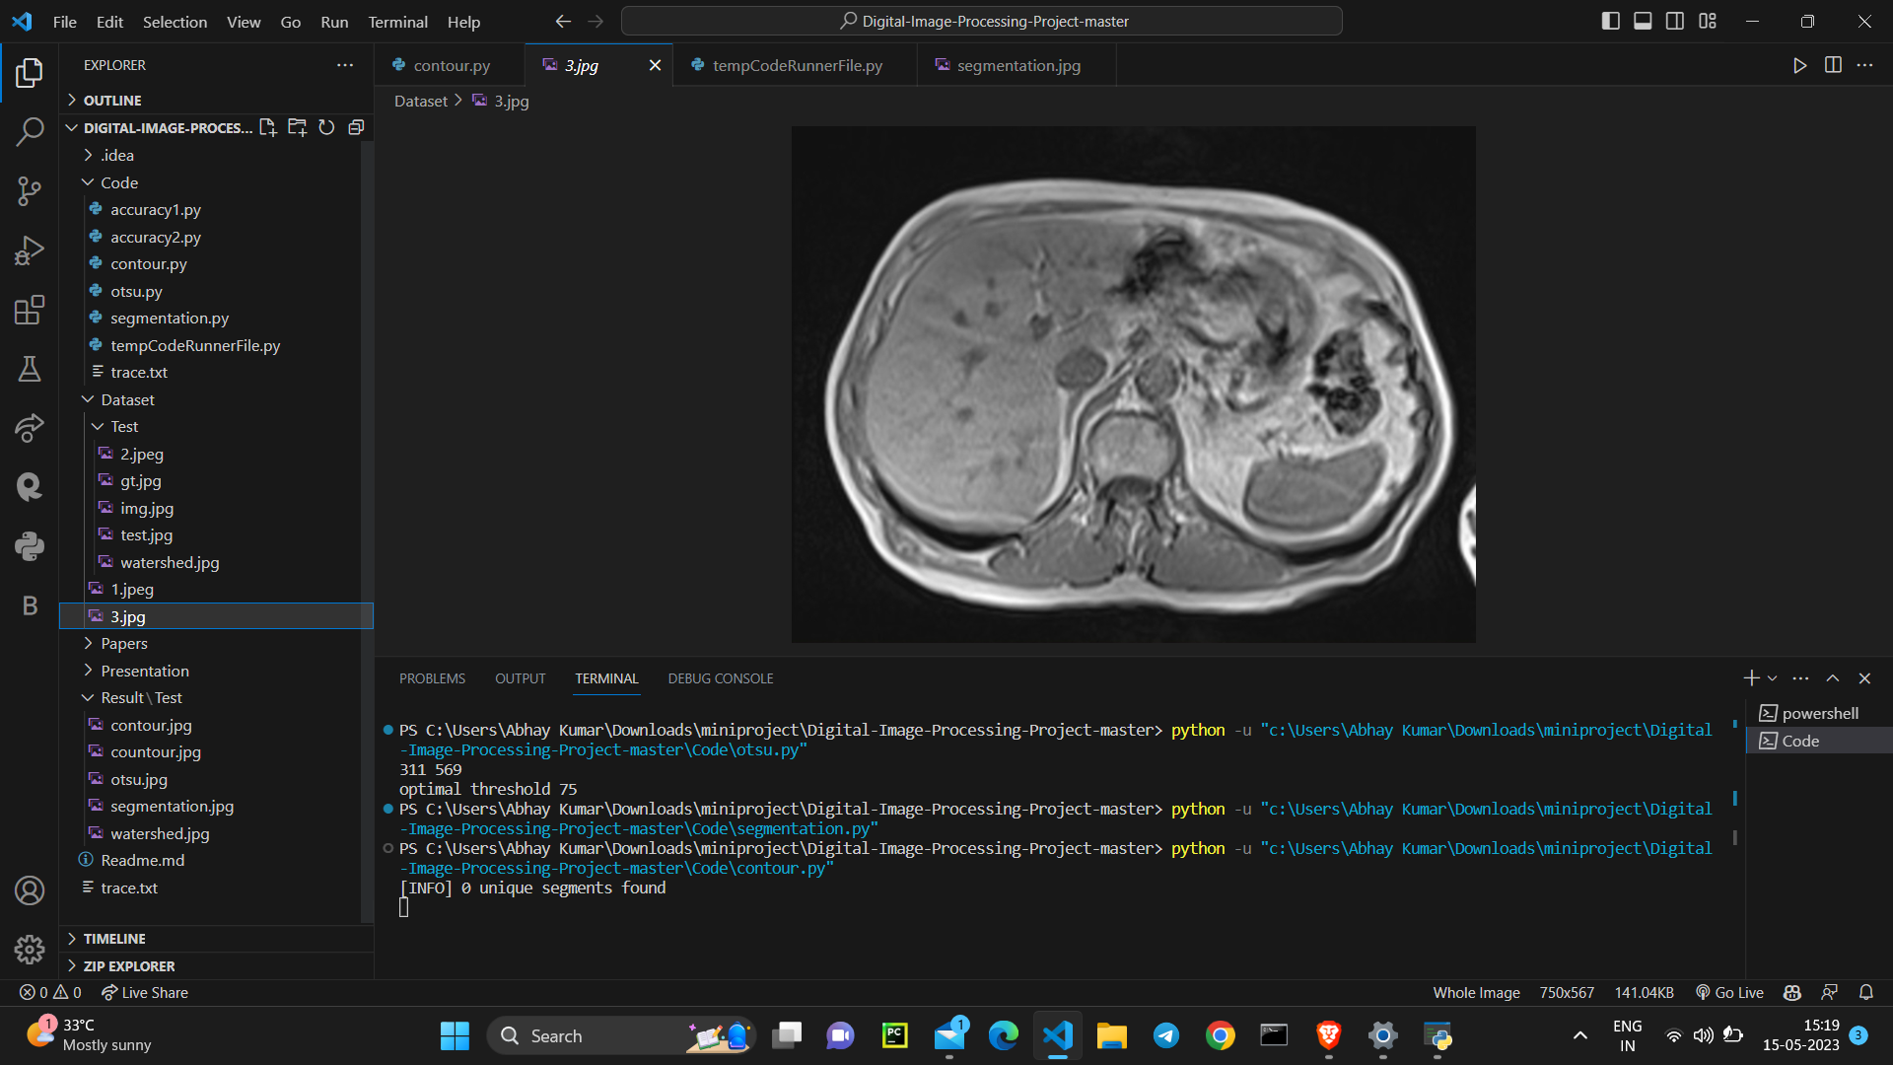
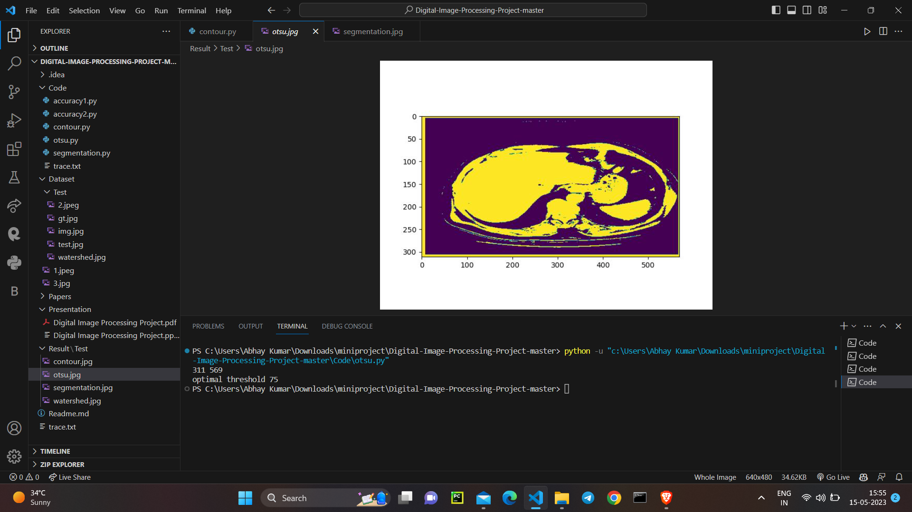
RESULTS & OBSERVATIONS
Bangalore Institute of Technology
Dept. of ECE, BIT

Slide 21
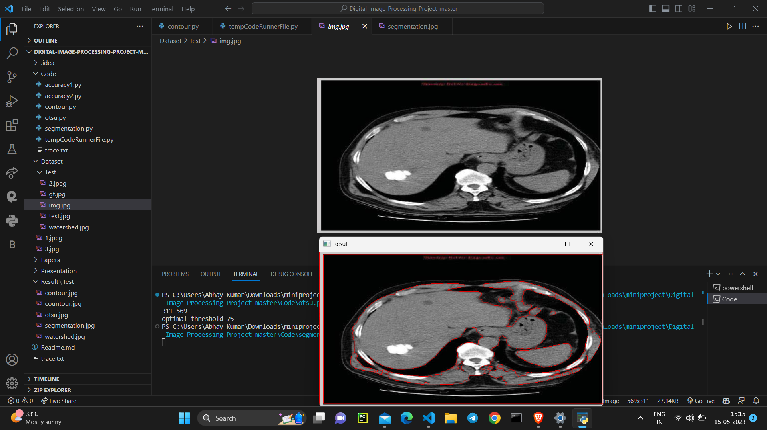
RESULTS & OBSERVATIONS
Bangalore Institute of Technology
Dept. of ECE, BIT

Slide 22
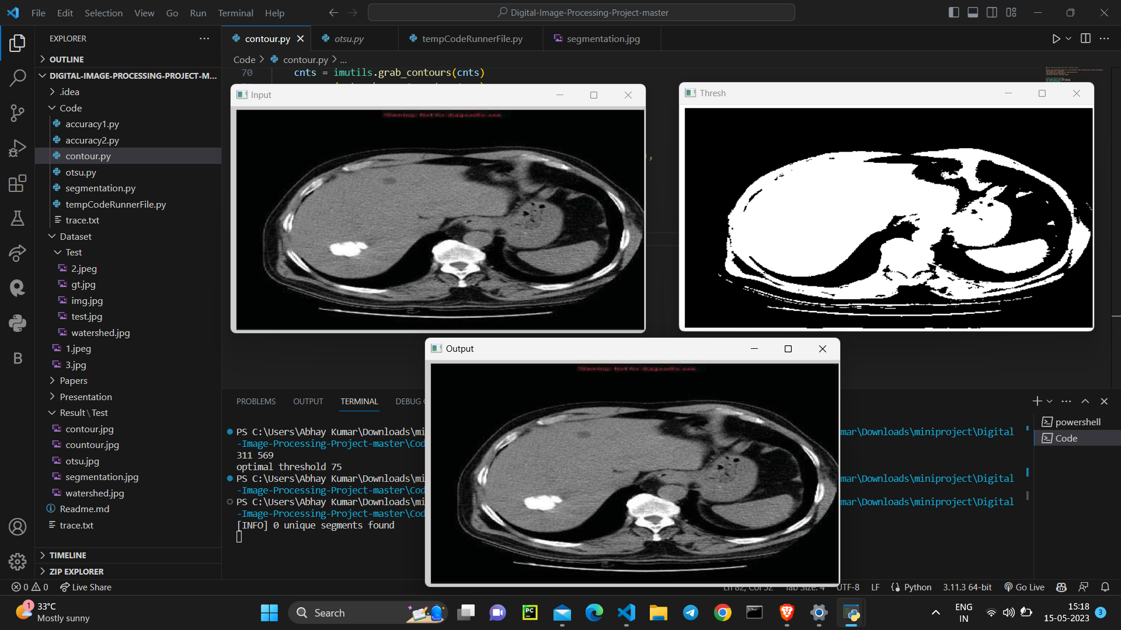
RESULTS & OBSERVATIONS
Bangalore Institute of Technology
Dept. of ECE, BIT

Slide 23
CONCLUSION (1 PAGE)
Following are the conclusions of the project.
Different MRI Images were acquired from the internet, basic Otsu preprocessing technique was used.
For segmentation, Marker-Controlled Watershed segmentation was used and it was observed that segmentation was done properly and the areas were identified accurately for most of the images.
For the accuracy part
For the base paper, the accuracy obtained comes out to be 74.93 %
According to other paper, we used active contour method(Implemented in project) and accuracy comes out to be 85.99%
Bangalore Institute of Technology
Dept. of ECE, BIT

Slide 24
FUTURE WORK (1 PAGE)
Morphological Erosion
Image erosion in this step is required to remove noisy undesirable parts appearing in the segmented image. Image erosion is applied on the image based on a structuring element object or an array of structuring element objects.
Internal liver tissues
In the future this work can be developed to solve leak problem in some cases where liver contour is not clear due to hepatomegaly, also the work can be extended in order to differentiate between internal liver tissues, the hepatic tumor lesions, and vessels
Gui based Application
The current project can be converted into a proper GUI based application. It can be either an android or a web application, so that it is handy for any normal user to detect liver cancers.
Bangalore Institute of Technology
Dept. of ECE, BIT

Slide 25
REFERENCES (2 PAGES)
All the references used are shown below
Nelofar Kureshi, Syed Sibte Raza Abidi, “A Predictive Model for Personalized Therapeutic Interventions in Non-small Cell Lung Cancer”, IEEE Journal of Health Informatics Vol. 20, No.1, pp 2016.
PR Anisha, CKK Reddy, LVN Prasad, "A pragmatic approach for detecting liver cancer using image processing and data mining techniques", International Conference on Signal Processing And Communication Engineering Systems (SPACES), India, pp.1-6, 2015.
F. J. Kaye, N. Lindeman, T. J. Boggon, K. Naoki, H. Sasaki, Y. Fujii, M. J., W. R. Sellers, B. E. Johnson, M. Meyerson, “EGFR mutations in lung cancer: Correlation with clinical response to gefitinib therapy”, Science, vol. 304, no. 5676, pp. 1497-1500, Jun. 2004.
Bangalore Institute of Technology
Dept. of ECE, BIT

Slide 26
REFERENCES (2 PAGES)
F. G. Haluska, D. N. Louis, D. C. Christiani, J. Settleman, D. A. Haber, “Activating mutations in the epidermal growth factor receptor underlying responsiveness of non-small-cell lung cancer to gefitinib”, New England J. Med., vol. 350, no. 21, pp. 2129-2139, 2004.
H. B. Kekre, A. Bild, E. S. Iversen, A. T. Huang, J. R. Nevins, M.West, “Integrated modeling of clinical and gene expression information for personalized prediction of disease outcomes”, Proc. Nat. Acad. Sci. vol. 101, no. 22, pp. 8431-8436, 2004
Bangalore Institute of Technology
Dept. of ECE, BIT

